Slide 1
Webs – Workflow case

Slide 2
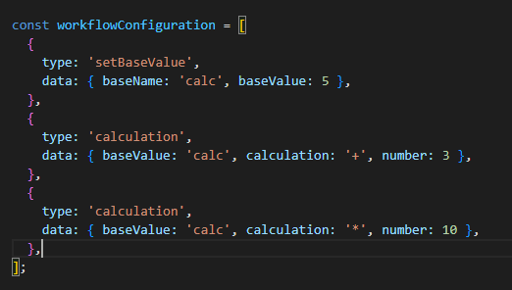
Goal: Make it easy to create custom workflows
Library of Workflow Steps
Workflow
WorkflowConfiguration
Step A
Step B
Step C
Step ..
Step ..
Needs:
Execute the same step multiple times
Add data to the workflow
Step ..

Slide 3
Key Philosophies
Use standardized classes to make classes comparable and modular
First validate than execute
Store data in a smart and reliable way
Easy to add workflow steps and workflows -> modular

Slide 4
Use standardized classes and methods
Generic class
Generic run and validate method (standard logging)
Framework for specific workstep classes
Workflow specific class
Always a validate and execute method
If a step is complicated break it down in multiple methods

Slide 5
First validate than execute
Still to do:
A lot of console logs -> should be saved in SQLite
Not checking if the data is of correct data types
Start execution
Validate if all steps are available
Validate if all steps have the necessary input
Execute workflow
To give a quick response if something is missing
Execute without modifying systems.
Check input and gives output for next steps
Executes the workflow

Slide 6
Store data in a smart and reliable way
Current construction:
Object that saved a context values and overwrites if the name is the same
Better solution:
Instance of an context class with getters and setters that protect data types. Here we could also define clear data structures in the workflowStep class of the input objects to validate key values.

Slide 7
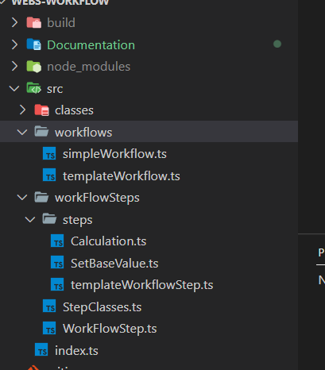
Modular module build
Easy to add new workflows and workflowSteps:
workflows:
- Create a copy of src/workflows/templateWorkflow.ts and follow the steps in the file.
- To run the workflow: ts-node ./src/workflows/fileName.ts (please change fileName to the new workflow).
workflowSteps:
- Create a copy of src/workflowSteps/templateWorkflowStep.ts and fill in the necessary methods.
- Add the new class to src\workFlowSteps\StepClasses.ts so that the new class is available for the workflows
- Add the new workFlowStep to a workflow

Slide 8
Things to add
- Add tests for basic functionality
- Add a SQLite / other method for execution logging
- Create a generic way for field validation (and type of)

